Slide 1

TCS Stock Data Analysis: Machine Learning Internship
Submitted by: Kamatham Sneha

Slide 2

Project Objective
Predicting Stock Prices
To clean historical TCS price data, perform Exploratory Data Analysis (EDA), engineer relevant features, and train a RandomForest model to predict the next day's closing price.
Dataset Overview
The primary dataset, TCS_stock_history.csv, includes columns like Date, Open, High, Low, Close, Adj Close, Volume, and Dividends.

Slide 3
Methodology & Key Steps
01
02
03
Data Cleaning
Exploratory Data Analysis (EDA)
Feature Engineering
Parsing dates, converting numeric columns, and sorting data by date for consistency.
Creating lag features (1-5), rolling means (5,10), day_of_week, and month as predictive features.
Visualising Close price, SMA20, SMA50, and a histogram of daily returns to understand trends.
04
05
Model Training
Evaluation
Utilising RandomForestRegressor with 200 trees, employing a time-aware train/test split (first 80% for training).
Assessing model performance using Mean Absolute Error (MAE), Mean Absolute Percentage Error (MAPE), and R-squared (R^2).

Slide 4

Results Summary
4463
841.03
33.37%
Rows in History Dataset
Model MAE
Model MAPE
Mean Absolute Error, indicating average prediction error.
Mean Absolute Percentage Error, showing prediction accuracy in percentage.
Total number of historical data points analysed.
-1.98
Model R2
R-squared value, reflecting the model's fit to the data.

Slide 5
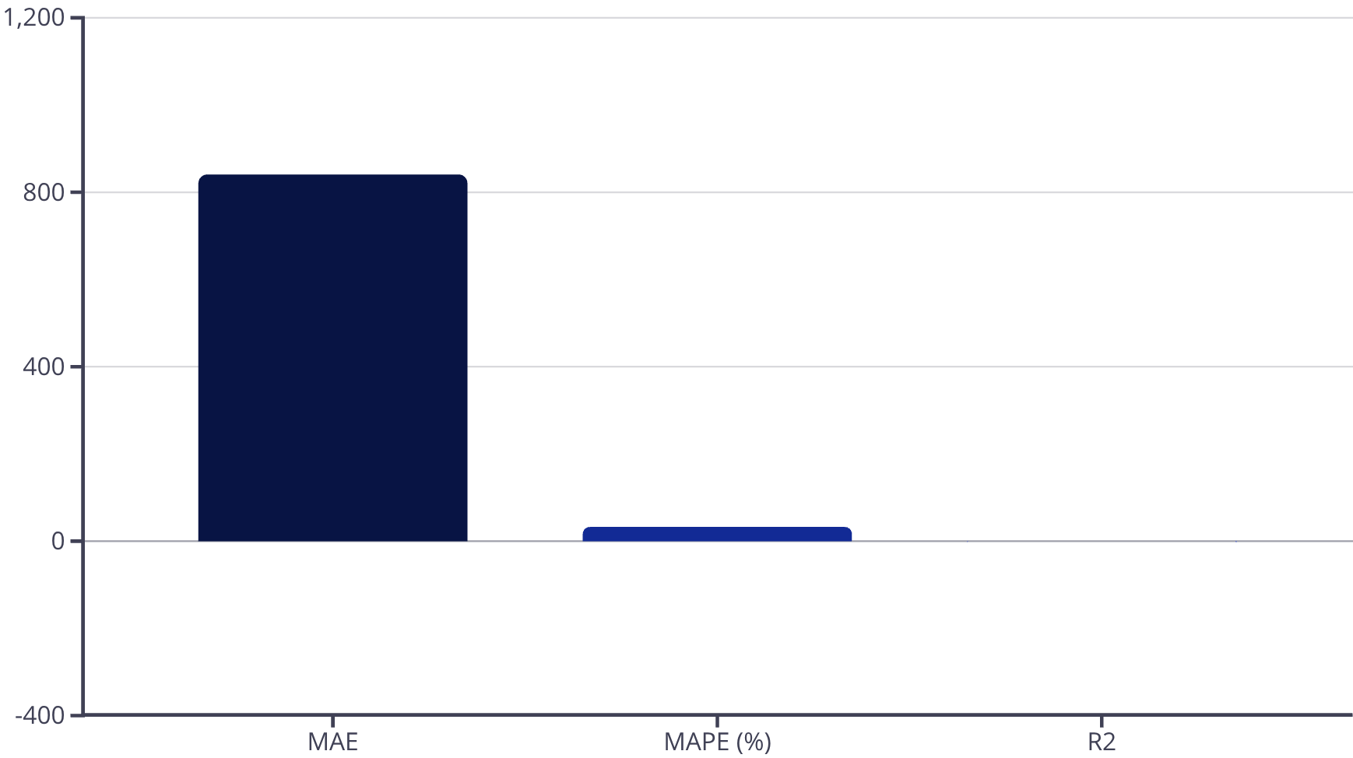

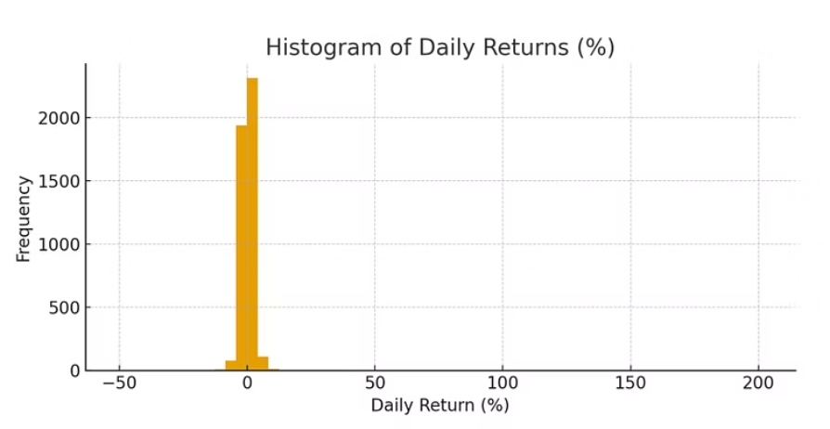
Performance Insights
The RandomForest model provides a baseline performance for predicting TCS stock prices. While the MAE and MAPE indicate areas for improvement, the R-squared value suggests that the current model needs further refinement to capture the complexities of stock market movements effectively.

Slide 6

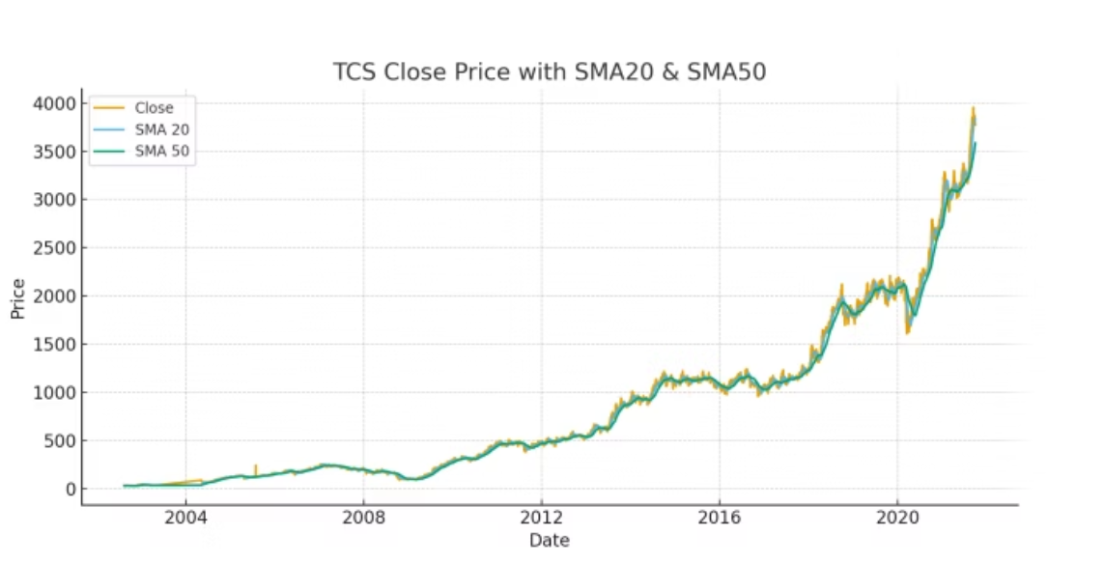
Conclusion & Future Work
Baseline Performance
Hyperparameter Tuning
The RandomForest model established a foundational understanding of stock price prediction.
Future work includes optimising model parameters to enhance predictive accuracy.
Additional Indicators
Incorporating more technical indicators could significantly improve model performance.

